Slide 1
Named Entity Recognition
A brief survey
Ivan Smurov

Slide 2
Overview
Task description
Classical approaches to the task
Neural networks based approaches and current state-of-the-art
From theory to practice

Slide 3
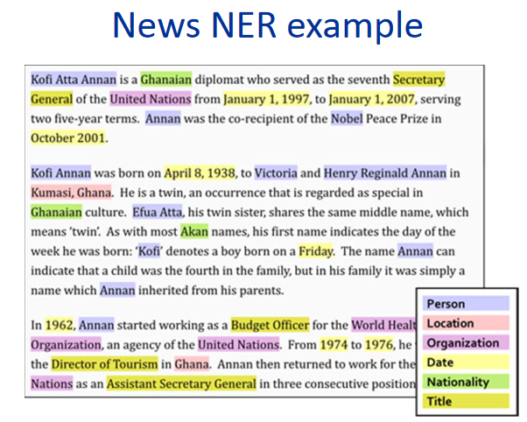
Task description
NER is the task of detecting named entities spans in text
Since first formal appearance (MUC-6, 1996) 3 entity types are most common – persons, locations and organizations
Various standard corpora can contain other entity types - Misc, Points of time, money, etc.

Slide 4
Practical applications
By itself NER is of limited usage (although there exist direct practical applications of NER – typically structuring unstructured data e. g. parsing text into data tables)
It is however a step towards “understanding” the text. Named entity recognition allows to identify important sections of the text, can be used to collect (or even simply mark down in a text) parts for further analysis etc.
Having NER implemented can improve the performance of systems solving other NLP tasks e. g. allow deeper analysis of search queries (named entities are reliable collocations, their identification can supplement coreference resolution)
Task description is flexible allowing to define a custom set of named entities for a specific application and tune the system to recognize them.

Slide 5
Challenges
Problem is more complex than it seems: you have to consider homonymy (Washington can be both person and location), take into account global context and pragmatic knowledge.
Virtually any set of named entities would have subtle and border cases of defining what should be considered named entity, where exactly should border between to entities be etc. (Grand Flower Shop v. s. animal shop Nemo v. s. Shopname – best clothing brands for reasonable prices).
Markup guidelines become more and more sophisticated which requires more qualified (and thus expansive) experts.

Slide 6
Evaluation metrics and standard corpora
The most common evaluation metric is strict f-measure( entity is considered true positive iff its spans in eval and gold standard are identical)
Markup is expensive and thus available corpora are in short supply
There are several shared tasks corpora for English NER: MUC, TAC, CoNLL. News texts are usual sources for such corpora.
English gold standard corpus is CoNLL 2003 (~300k tokens, entities: LOC, PER, ORG and Misc). SOTA f-measure~ 0.915
For Russian NER there exist one corpus from Dialogue 2016 conference (~50к tokens).

Slide 7
NER as classification problem
BIOES-shcema John Frederic Smith sold Google ->
B-PER I-PER E-PER OUT S-ORG
Nested entities – Smith, Brown & Associates.
Standard data format is conll-format. Text is splitted into sentences, each sentence is splitted into tokens. One line corresponds to one token. Columns contain all information necessary for token analysis (word, POS-tag, label etc)

Slide 8
Classical approaches
Strictly speaking NER can be solved without machine learing. Rule-based systems can perform well enough for specific corpora or entity types(e. g. numerical entities – points of time, money etc)
However until late 2000-х, SOTA-results were achieved by systems exploiting classical machine learning methods (HMM, MEMM, SVM, CRF, random forests, their combinations etc)
Most common features are were, POS-tags, elements of morphology (prefixes, suffices) whether tokens contained special symbols, features connected to form of tokens(capitalization, presence of punctuation). The most general of the last category are capitalization templates(iPhone6 -> aAaa1)
Gazetteers (entities lists) are also common means of improving performance
A survey of classical approaches to solving NER task in Nadeau and Sekine (2007), A survey of Named Entity Recognition and Classification

Slide 9
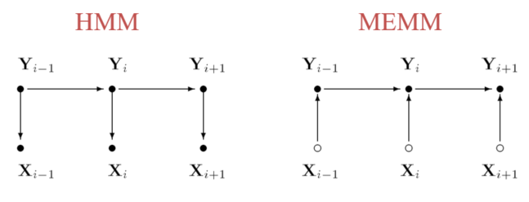
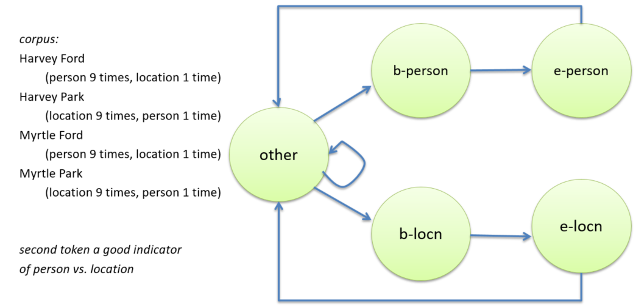
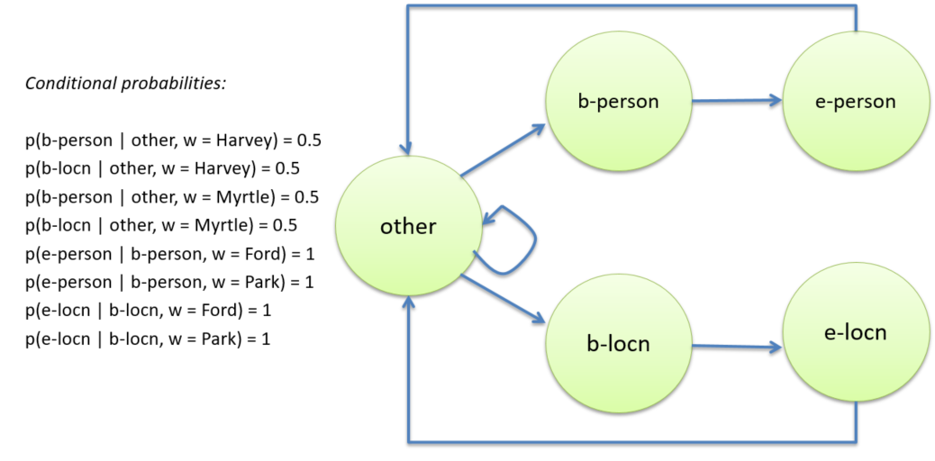

Label bias problem
Labels in IOBES schema depend on each other. E. g. I-Per label can follow only B-Per or I-Per and no other labels.
In HMM and MEMM probabilities of outgoing arcs normalized separately for each state: label bias problem

Slide 10
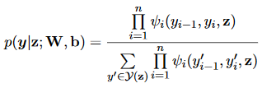


Conditional random field
Input sequence: , label sequence for z:
CRF optimizes the conditional probability of the whole output sequence given input sequence where is se set of all possible labels and
When training on set the log-likelihood of is maximized
Decoding for test set is to search for the label sequence with the highest conditional probability:
For linear chain CRF both training and decoding can be solved efficiently by adopting Viterbi algorithm (simple dynamic on paths)

Slide 11
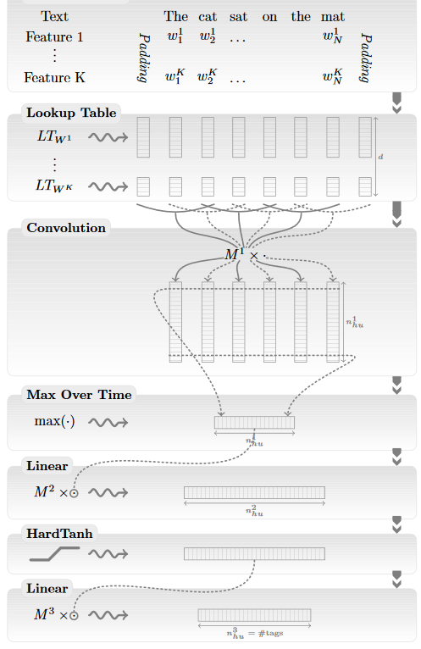
First neural net approaches
First successful implementation of neural nets for solving NLP task in Collobert el al (2011), Natural Language Processing (Almost) from Scratch
Article introduces 2 methods: window based and sentence based. Second one yields better results but more complex
Features: word embeddings + handcrafted features(capitalization, POS-tags etc)
Model with gazetteers demonstrated SOTA-result on CoNLL 2003

Slide 12
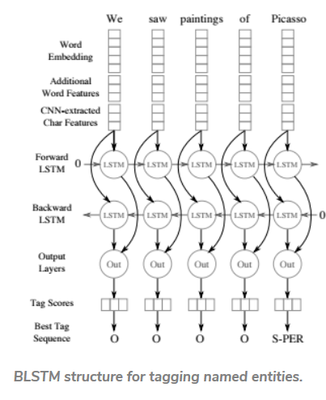
Modern approaches: Char CNN + BLSTM + CRF
Currently most popular architecture is as follows:
Features of all tokens in given sentence (possibly bounded by paddings and/or context from neighboring sentences) are fed into Bidirectional RNN
CRF is well-suited for being last layer: it arranges labels into matching chains(and increases f-measure on CoNLL03 ~ 1%)

Slide 13
Char CNN + BLSTM + CRF: token features
Usually token features can be split into 3 groups:
Word embeddings. In academia embeddings pretrained on large corpus are usually tuned on smaller corpus. In practice having constant pretrained embeddings yield similar results
Char-level features: char embeddings for each token are fed into CNN (or RNN) of limited dim. The result isconcatenated with other token features
Additional token features: POS-tags (or their embeddings), capitalization etc.
Method first introduced in its whole in : Ma and Hovy (2016) End-to-end Sequence Labeling via Bi-direcitonal LSTM-CNNs-CRF and Lample el al (2016) Neural Architectures for Named Entity Recognition

Slide 14
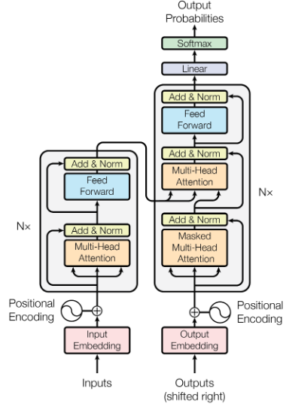
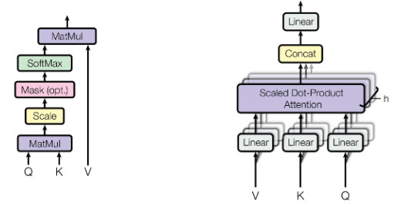
Transformer architecture
Vaswani et al (2017) Attention is all you need

